Slide 1
3D Vision Summer School
A Tutorial on
Beginning with 3D Vision Understanding
IIIT Hyderabad
Siddharth, Shanthika

Slide 2
Content Links
Google slides link: https://tinyurl.com/2p8949j3
VoxNet Colab Notebook link: https://tinyurl.com/34s754kc
PointNet Colab Notebook link: https://tinyurl.com/28pmjvhr
PointNet++ Colab Notebook link: https://tinyurl.com/28emjbxn

Slide 3
Overview
VoxNet
3D Data Processing
PointNet
PointNet++

Slide 4
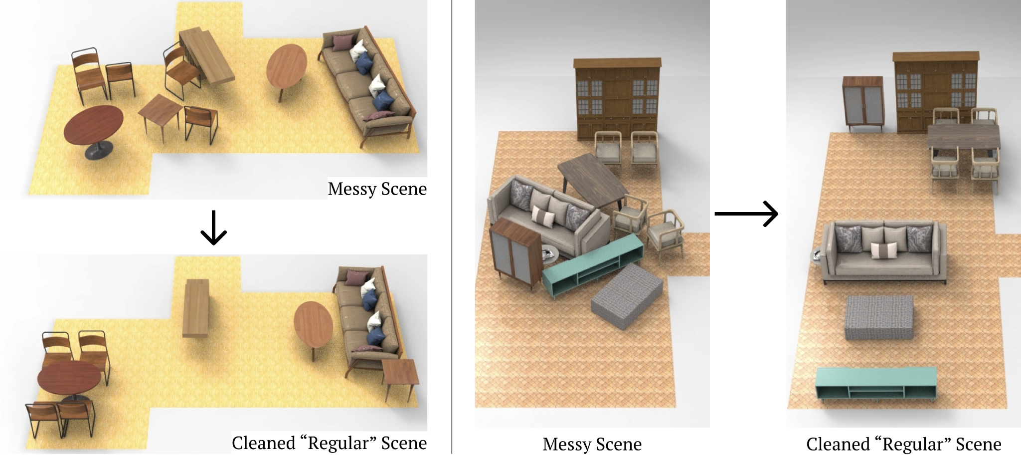
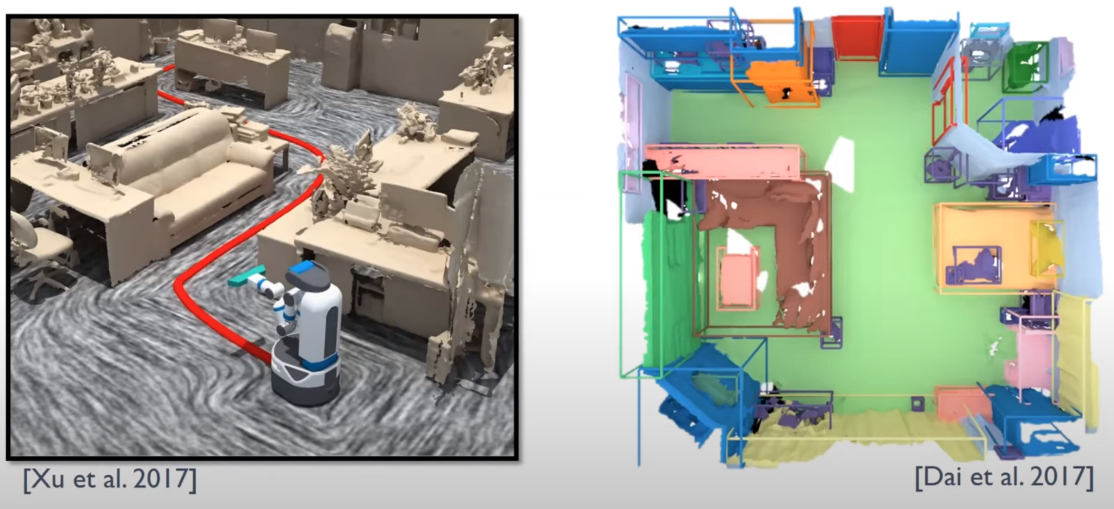
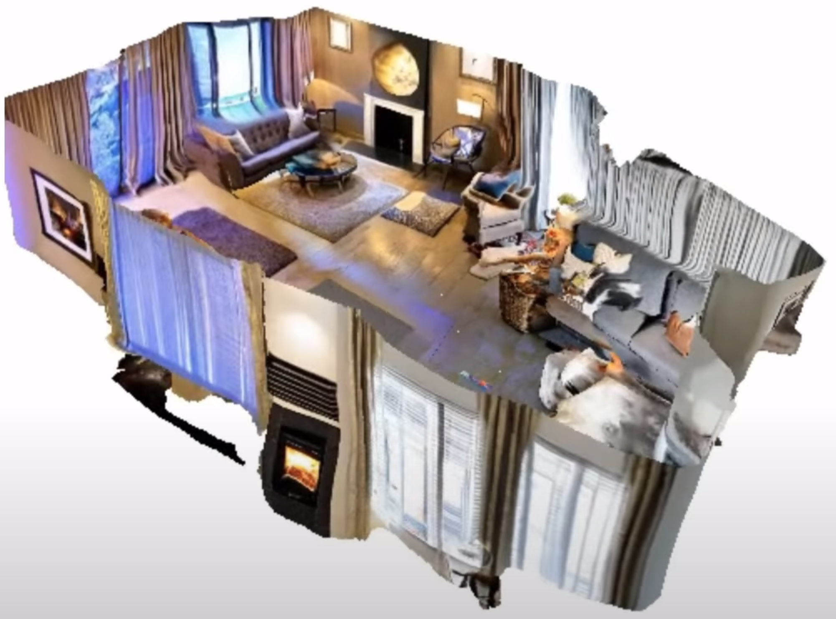
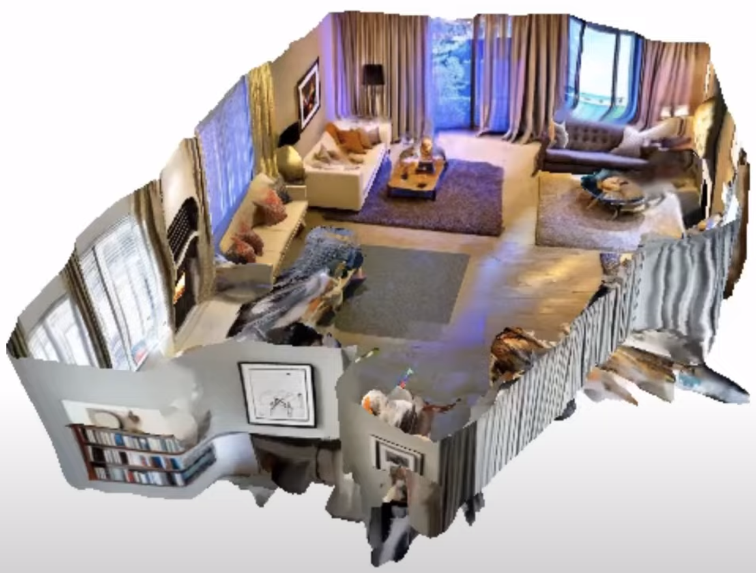
Motivation
Wei et al. 2023
Dai et al. 2017
Xu et al. 2017
“A lit living room with a lit furnace, couch and cozy curtains, bright lamps that make the room well lit.”
Hollein et al. 2023

Slide 5

ModelNet Dataset
ModelNet40 is a large 3D CAD model dataset containing 40 categories

Slide 6
VoxNet
Colab Notebook link: https://tinyurl.com/34s754kc

Slide 7
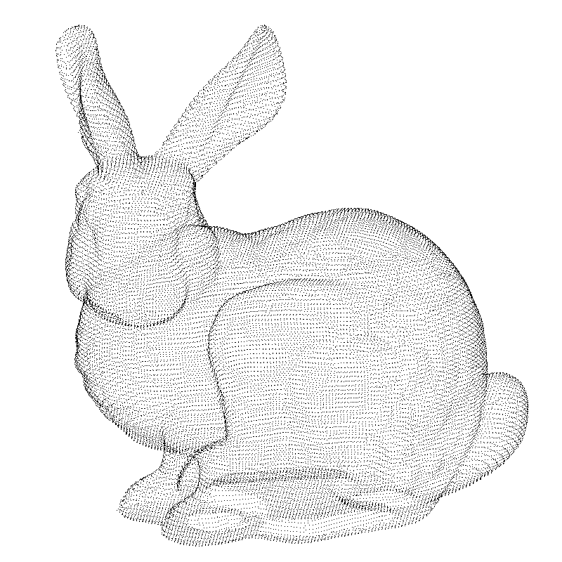
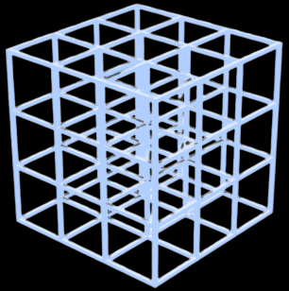
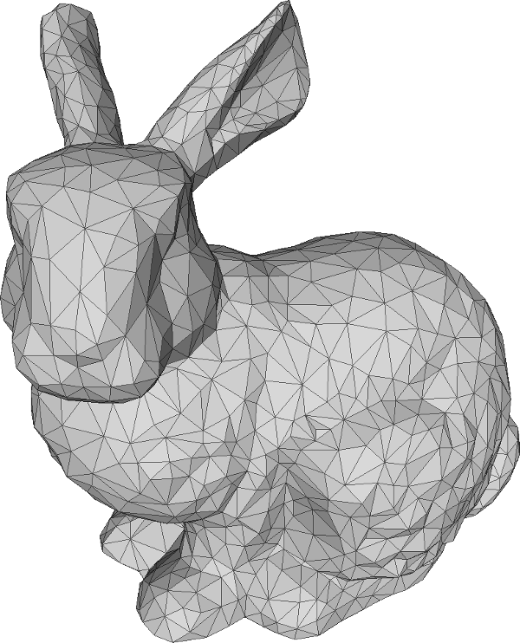
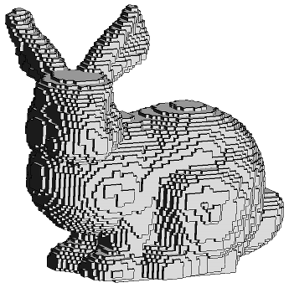
Voxelization
Pointcloud
Mesh
Voxelized Representation
Voxelized Grid

Slide 8
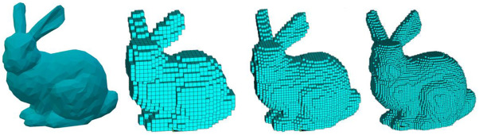
Effect of Voxel Size
Bunny Mesh
1 mm
0.6 mm
0.4 mm

Slide 9
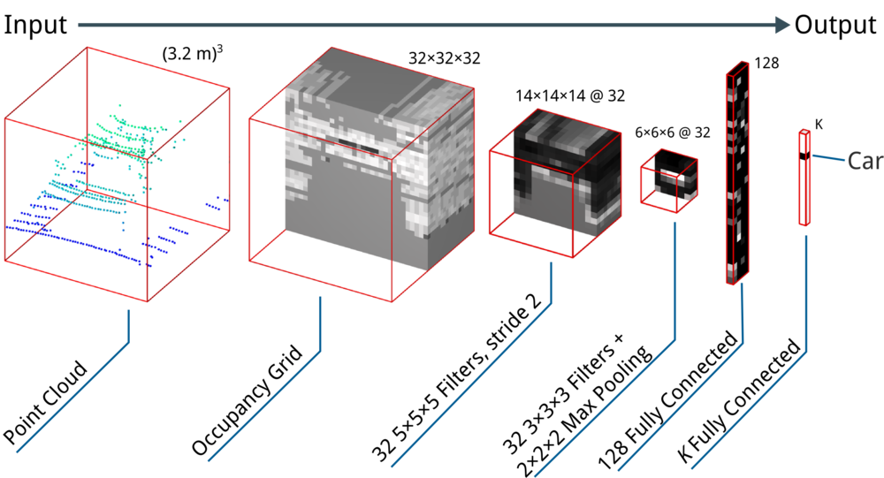
VoxNet Architecture

Slide 10
Advantages and Disadvantages
Advantages:
Fast Processing
Disadvantages:
High memory consumption
Most of the voxels are unoccupied
Loss of fine grain object geometry

Slide 11
PointNet
Colab Notebook link: https://tinyurl.com/28pmjvhr

Slide 12
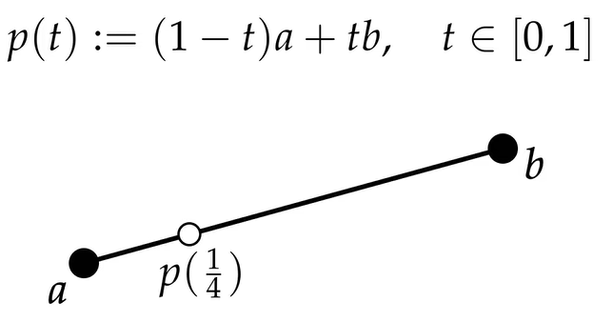
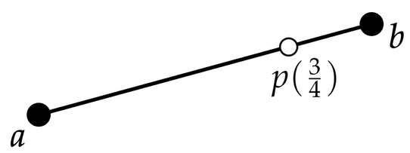
Barycentric Coordinates
We can traverse a line by taking a weighted sum of the vertices.
For a Line:
t and (t-1) are the barycentric coordinates of point p.
If a = 3, b = 6;
p(1/4) = 2.25 + 1.5 = 3.75
If a = 3, b = 6;
p(3/4) = 0.75 + 4.5 = 5.25

Slide 13
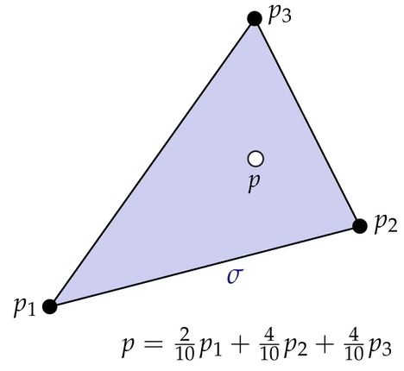
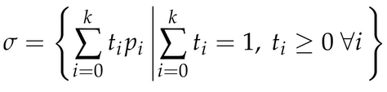
Barycentric Coordinates
We can traverse a triangle by taking a weighted sum of the vertices.
For a Triangle:
2/10, 4/10, 4/10 barycentric coordinates of point p.

Slide 14
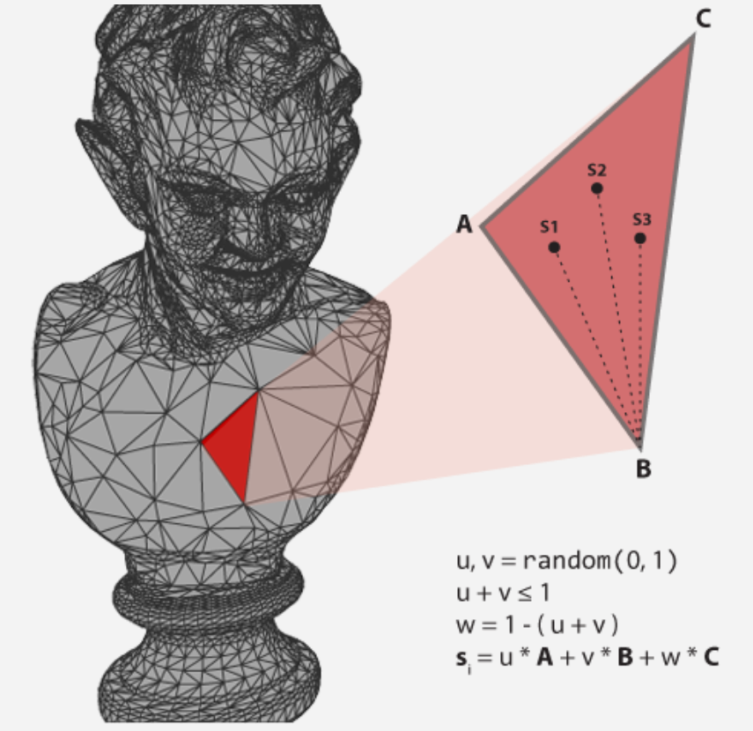
Surface Point Sampling
We can give random barycentric coordinates, to sample a random point from a triangle face.

Slide 15
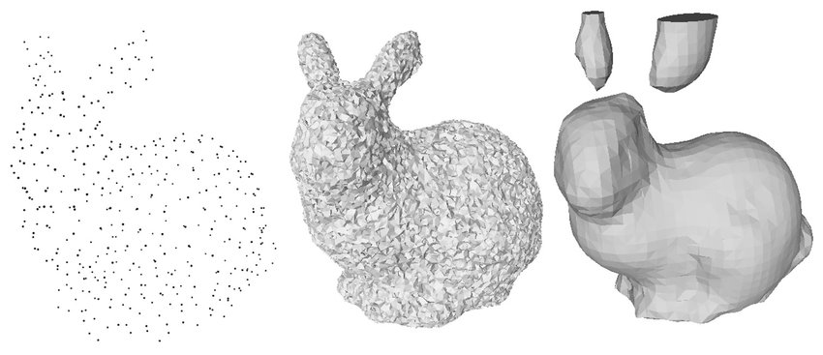
Farthest Point Sampling (FPS)

Slide 16
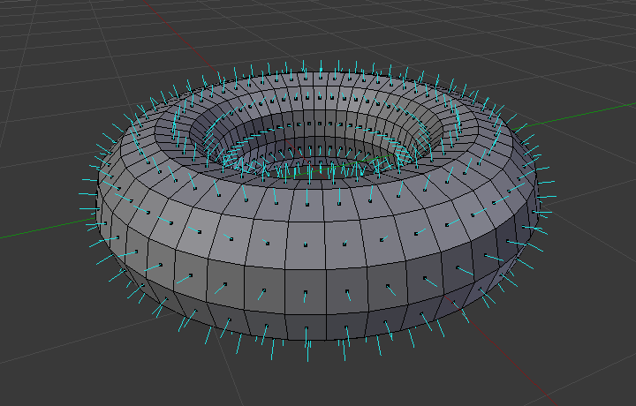
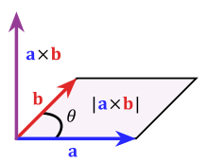
Face Normal Estimation

Slide 17
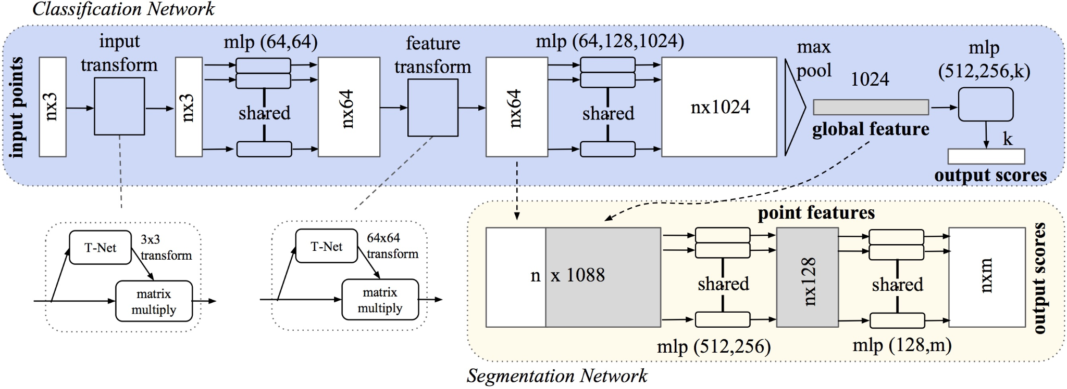
PointNet Architecture
Network should be invariant to any point ordering.
Local Embedding
Global Feature
There is no point-to-point interaction, leading to weak local features!!

Slide 18
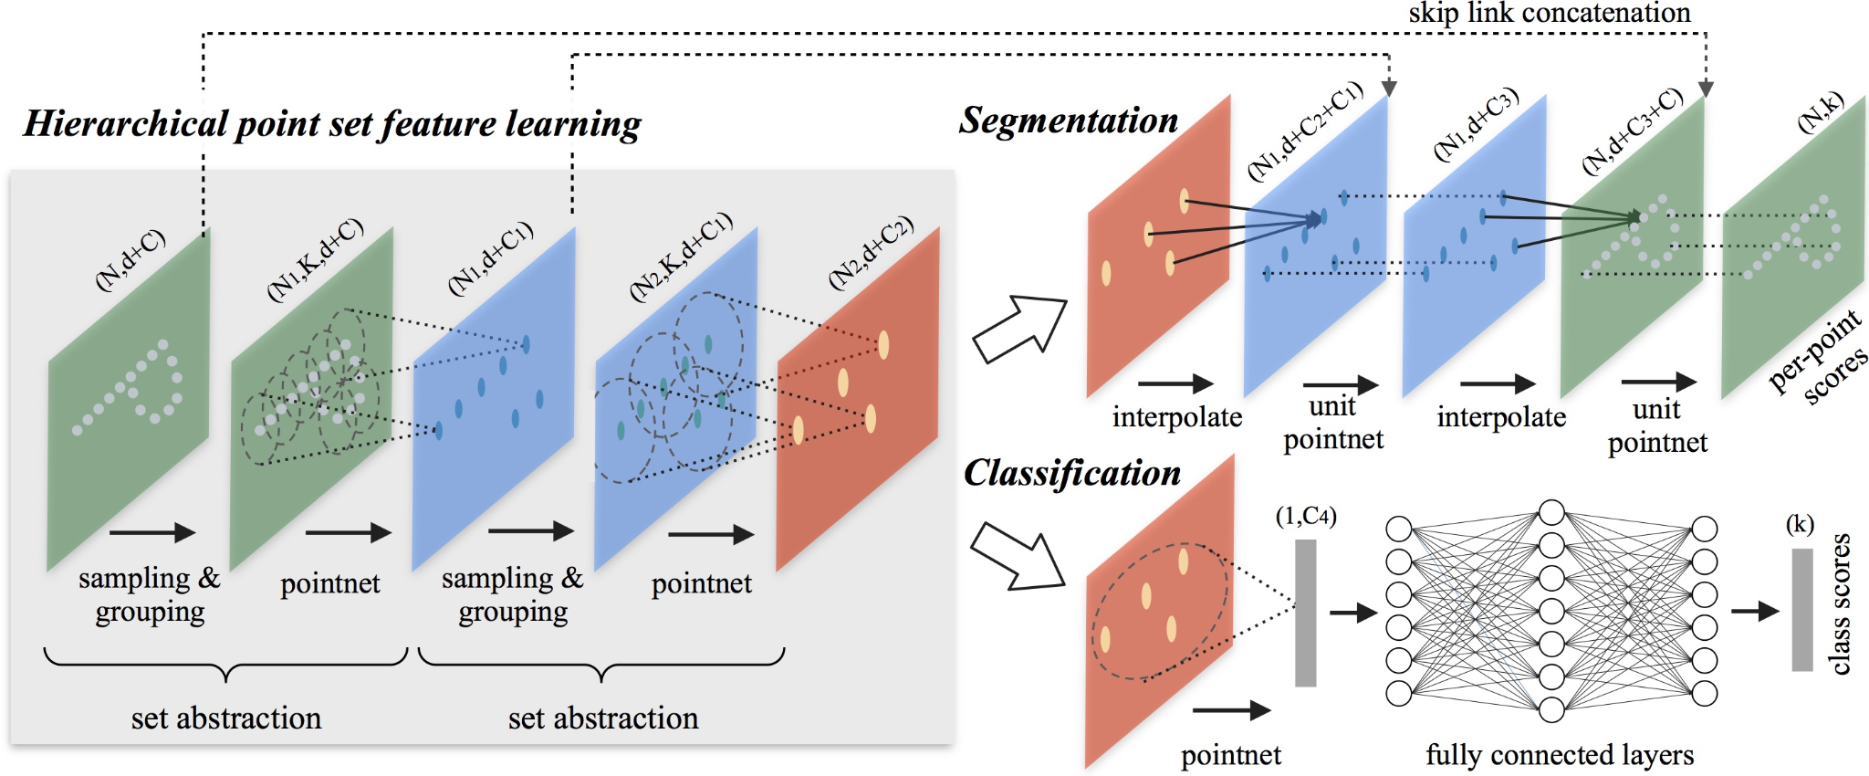
PointNet++ Architecture
Key modules
Sampling
Grouping
PointNet
Global Feature
Extracting hierarchical features, going from local to global!!

Slide 19
PointNet++ Architecture
Colab Notebook link: https://tinyurl.com/28emjbxn

